Slide 1
Customer Churn Detection
Submitted by :-
Gaurav Dhamija

Slide 2
Contents
Importing the libraries
Loading the data
Data manipulation
Creating the DataFrame
Data Visualization
Splitting DataFrame in Train and Test
Feature Scaling
Machine Learning Model Building
Models used

Slide 3
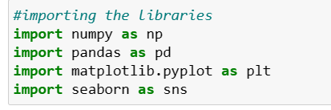
Libraries
Pandas
Numpy
Matplotlib
Seaborn
Scikit learn
Statsmodels

Slide 4
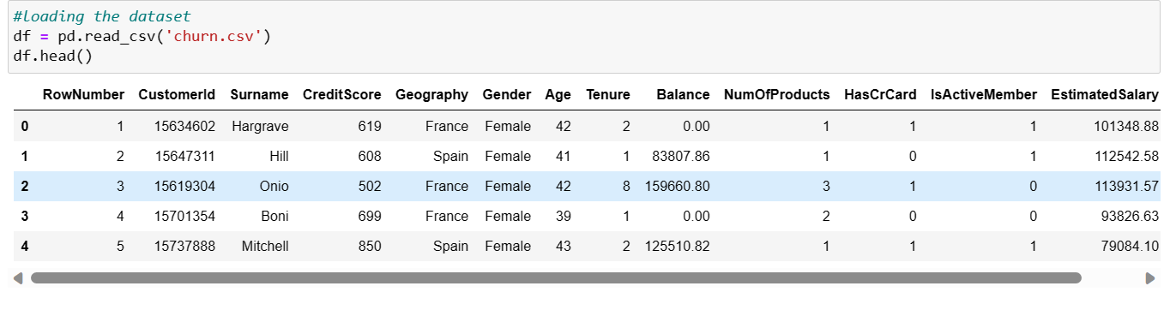
Data Loading
It is the data that we need to load for starting any of the ML project.

Slide 5
Data Manipulation
Data manipulation refers to the process of altering, modifying, or transforming data to extract meaningful insights, improve data quality, or prepare it for specific analysis or reporting purposes.
It includes various process which is shown further slide.

Slide 6
Data cleaning
Data transformation
Data filtering
Data aggregation
Data merging
Data normalization
Data reshaping
Data sampling
:

Slide 7
Data Visualization
Data visualization is the representation of data through use of common graphics, such as charts, plots, infographics, and even animations.
These visual displays of information communicate complex data
relationships and data-driven insights in a way that is easy to understand.

Slide 8
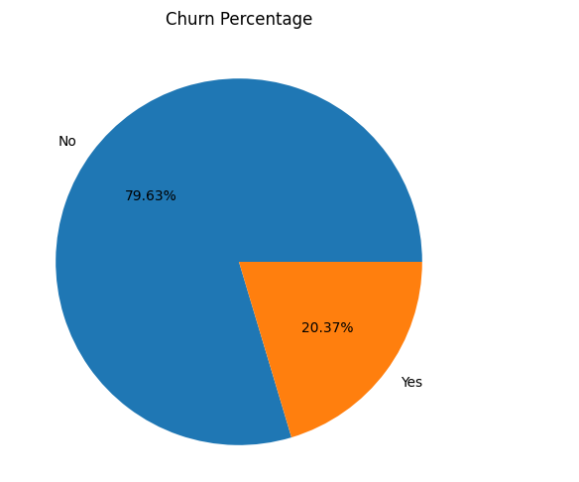
The pie chart clearly visualizes the customer churn in the dataset. The majority of the customers in the dataset continue to use the services of the bank with only 20.4% of the customers churning.

Slide 9
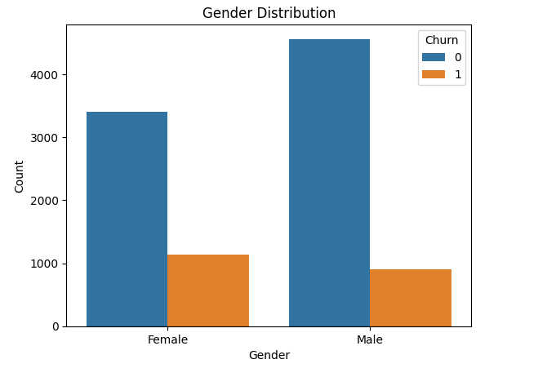
As shown in the graph, majority of the customers are male. But upon looking at the customer churn, we can see that females have more tendency to churn as compared to males. However there is not much difference between the churn count of the two genders so we cannot have a hypothesis regarding the customer churn based on the gender of the customer.

Slide 10
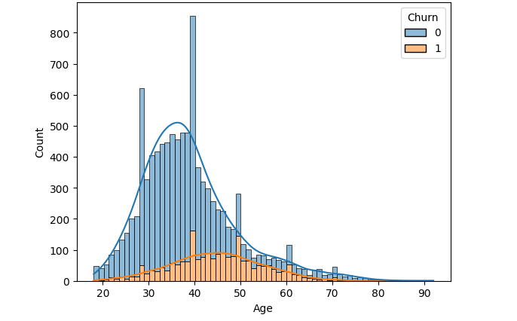
This histogram visualizes the age distribution and the churn count of the customers. The majority of the customers are from age group 30-40 years old. However the customer churn count is highest for the customers of age 40 and 50. In addition to that customers from age group 20-25 years old count for the lowest churn count. Therefore, age plays a significant role in customer churn, where late adults are more likely to churn as compared to young adults with minimal churn count

Slide 11
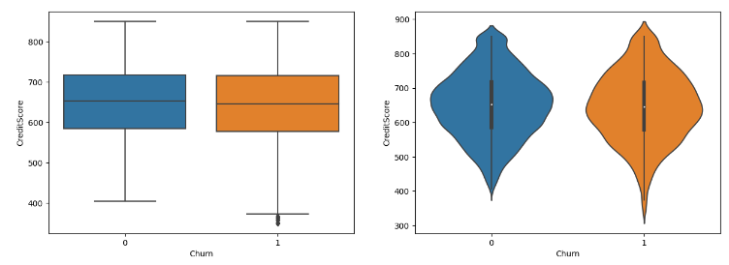
The boxplot and violin plot shows the distribution of customer's credit score along with their churn. In the boxplot, the median of both the churn and non churn customers are almost same. In addition to that, the shape of violin plot is also similar for both the churn and non churn customers. However some churn customers have low credit score, but on the whole, the credit score is not a good indicator of churn.

Slide 12
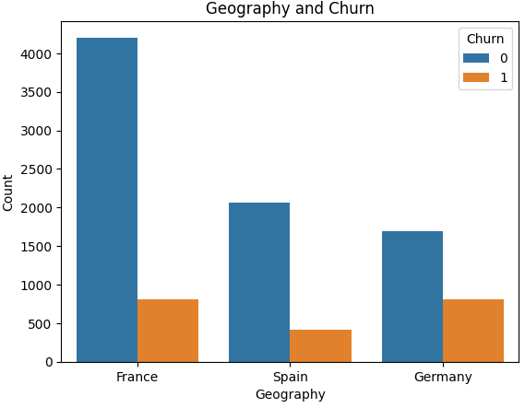
This graphs shows the number of customers from the their respective countries align with their churn count. Majority of the customers are from France, followed by Spain and Germany. However in contrast to that Germany has the highest number of customer churn followed by France and Spain. From this we can infer that German customers are more likely to churn than the customers from other countries.

Slide 13
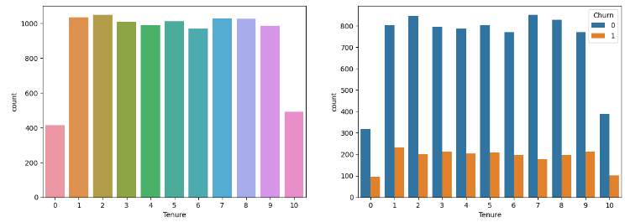
Tensure refers to the time (in years) that a customer has been a client of the bank. Majority of the customers in the dataset have a tenure between 1-9 years, having equal distribution among them. There are very few customers with a tenure of less than 1 years or more than 9 years. Looking at the churn of these customers based on their tenure, it can be observed that customers with tenure 1-9 years have higher churn count with maximum in customers with 1 year tenure followed those with 9 year tenure. However customers more than 9 years on tenure counts for the least churn. This is because the customers with higher tenure are more loyal to the bank and less likely to churn.

Slide 14
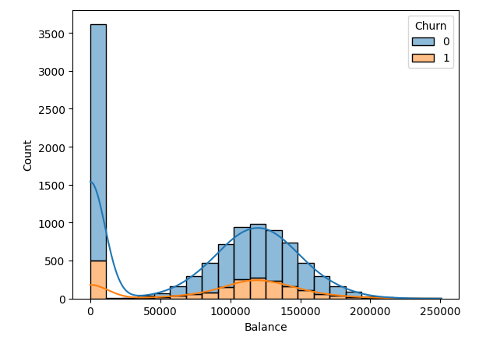
A huge number of customers have zero bank balance which also resulted in them leaving the bank. However, customer having bank balance between 100000 to 150000 are more likely to leave the bank after the customers with zero bank balance.

Slide 15
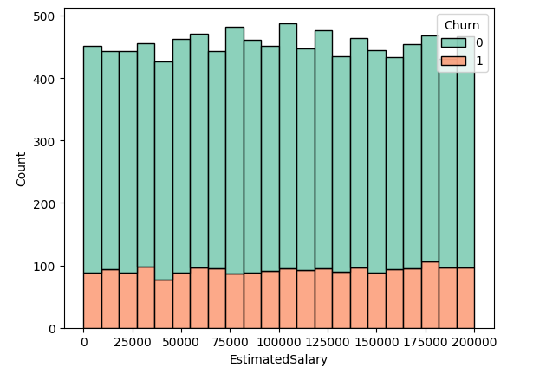
This graph shows the distribution of the estimated salary of the customers along with the churn count. On the whole the there is no definite pattern in the salary distribution of the customers who churned and who didn't. Therefore estimated salary is not a good predictor of churn.

Slide 16
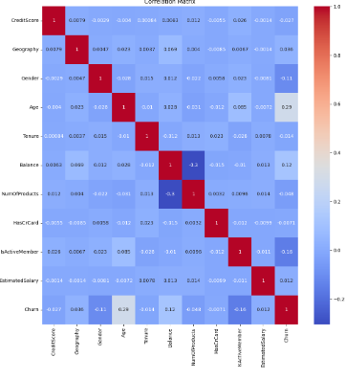
There is no significant coo-relation among the variables. So, I will proceed to model building.

Slide 17
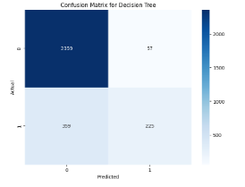
The True Positive shows the count of correctly classified data points whereas the False Positive elements are those that are misclassified by the model. The higher the True Positive values of the confusion matrix the better, indicating many correct predictions.

Slide 18
Data Visualization
Data visualization is the graphical representation of data and information to present complex datasets in a more accessible and understandable form.
The main goal of data visualization is to visually
communicate insights, patterns, and trends that might not be easily apparent when examining raw data alone.
By using visual elements like charts, graphs,maps, and other graphical representations, data visualization helps users interpret and draw meaningful conclusions from data quickly and effectively.

Slide 19
Splitting DataFrame in Train and Test
In this , X is Independent Variable whereas ,
y is dependent variable.

Slide 20
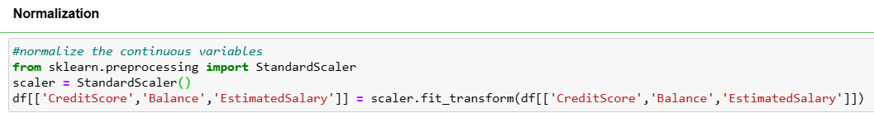
Feature Scaling
Feature scaling is the process of normalizing
the range of features in a dataset.

Slide 21
ML model building
Building a model in machine learning is creating a mathematical representation by generalizing and learning from training data.
Then, the built machine learning model is applied to new data to make predictions and obtain results.

Slide 22
Models used
Decision Tree Classifier
Random Forest Classifier

Slide 23
Accuracy
Models used | Accuracy ( in %)
Decision Tree classifier | 85
Random Forest classifier | 87

Slide 24
Conclusion
The Random Forest classifier model gives
best accuracy among all the models which
is : 0.8767142857142857
Or
in Percentage we can say 87%.

Slide 25


